Slide 1
The Math

Slide 2
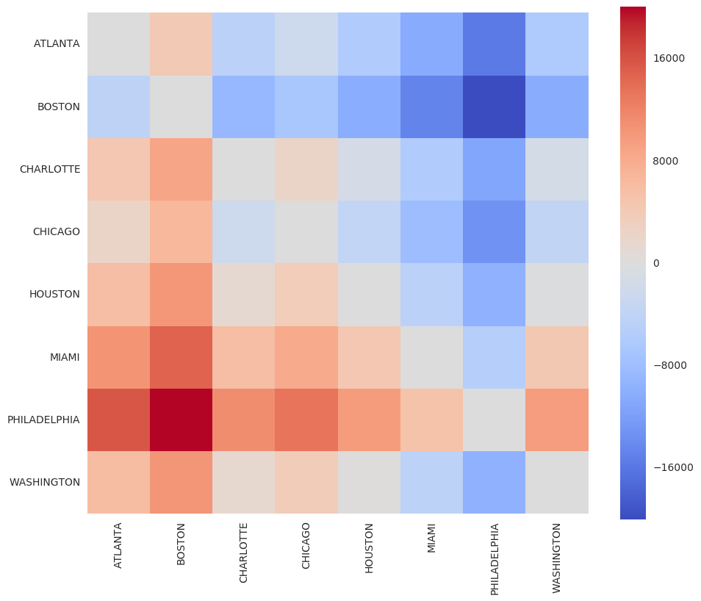
Which city to sent?
Blue: Go!
Red: expensive place to go to.

Slide 3
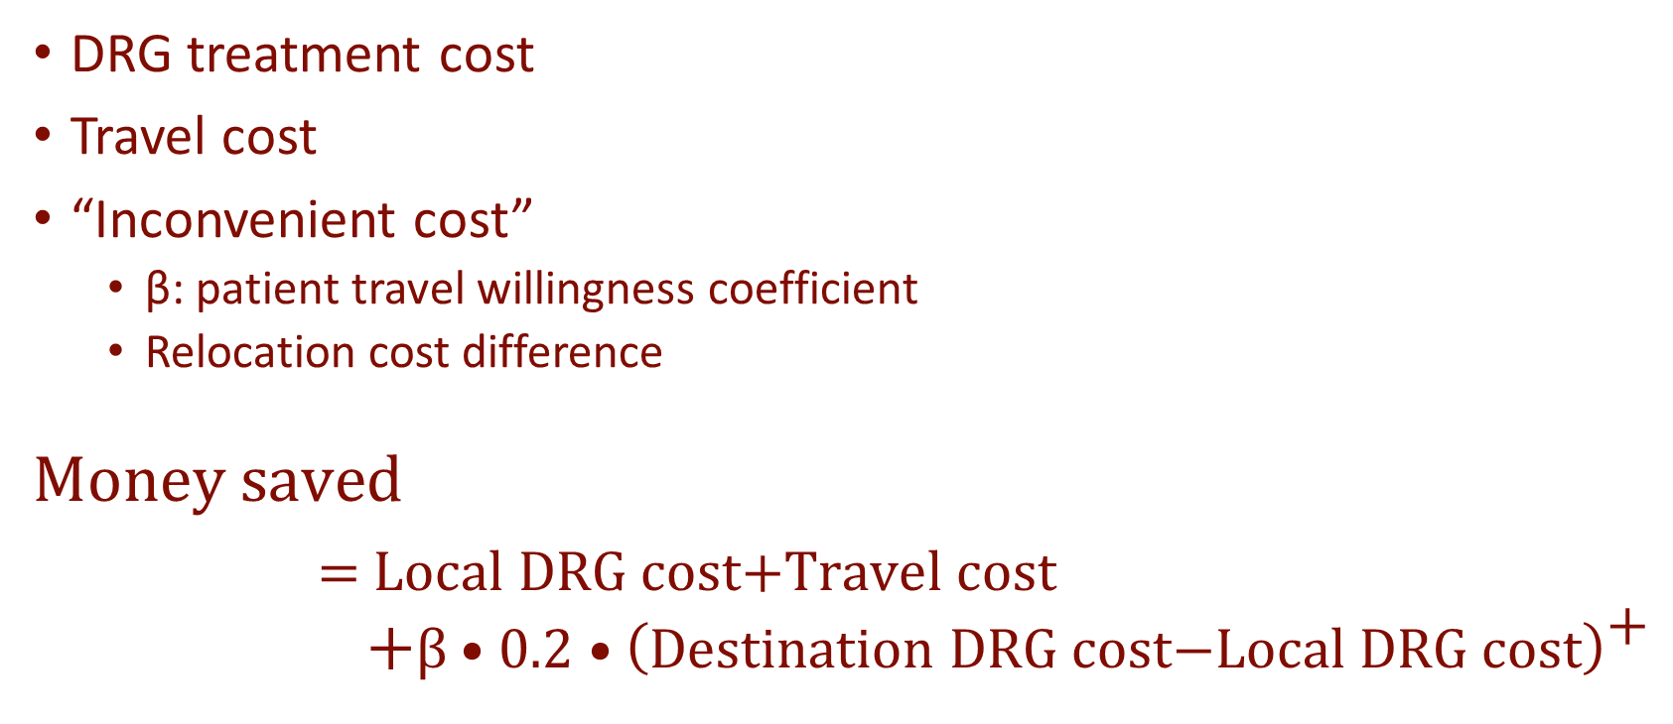
Equation statement

